Slide 1
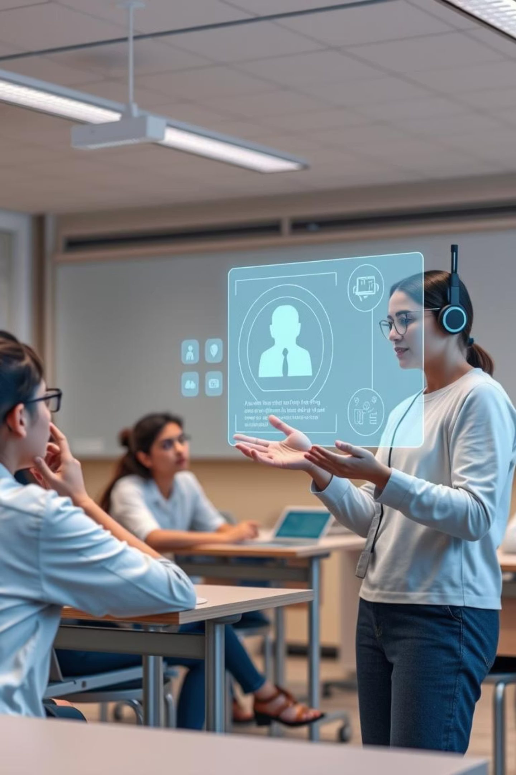
AI-Powered Interactive Learning Assistant
This project introduces an AI-powered assistant designed to enhance the classroom learning experience through real-time interaction. The assistant supports multiple modes of input—text, voice, and images—to cater to diverse student needs. It leverages advanced AI models to generate intelligent, context-aware responses while maintaining student engagement through facial emotion analysis and visual aids.

Slide 2
Problem Statement
Challenges in Modern Education:
Classrooms today are often not equipped to provide individualized attention or real-time feedback to students.
Many students hesitate to ask questions, especially in group settings, which leads to gaps in understanding.
Teachers also face difficulty in identifying disengaged students without visual or behavioral cues.
A solution is needed that can interpret students’ queries in real-time, adapt responses accordingly, and monitor their engagement dynamically.

Slide 3





Objectives
Core Goals of the System:
Multimodal Input
Context-Sensitive Answers
Engagement Monitoring
To build a smart assistant capable of accepting queries in multiple formats including typed text, spoken words, and even images such as diagrams.
To provide accurate, context-sensitive answers using natural language processing (NLP).
To monitor student behavior through facial expression detection and issue appropriate interventions if disengagement is detected.
Visual Aids
Fallback Mechanisms
To display answers along with relevant charts or diagrams when necessary for improved understanding.
To implement fallback mechanisms when the AI cannot answer a question confidently.

Slide 4
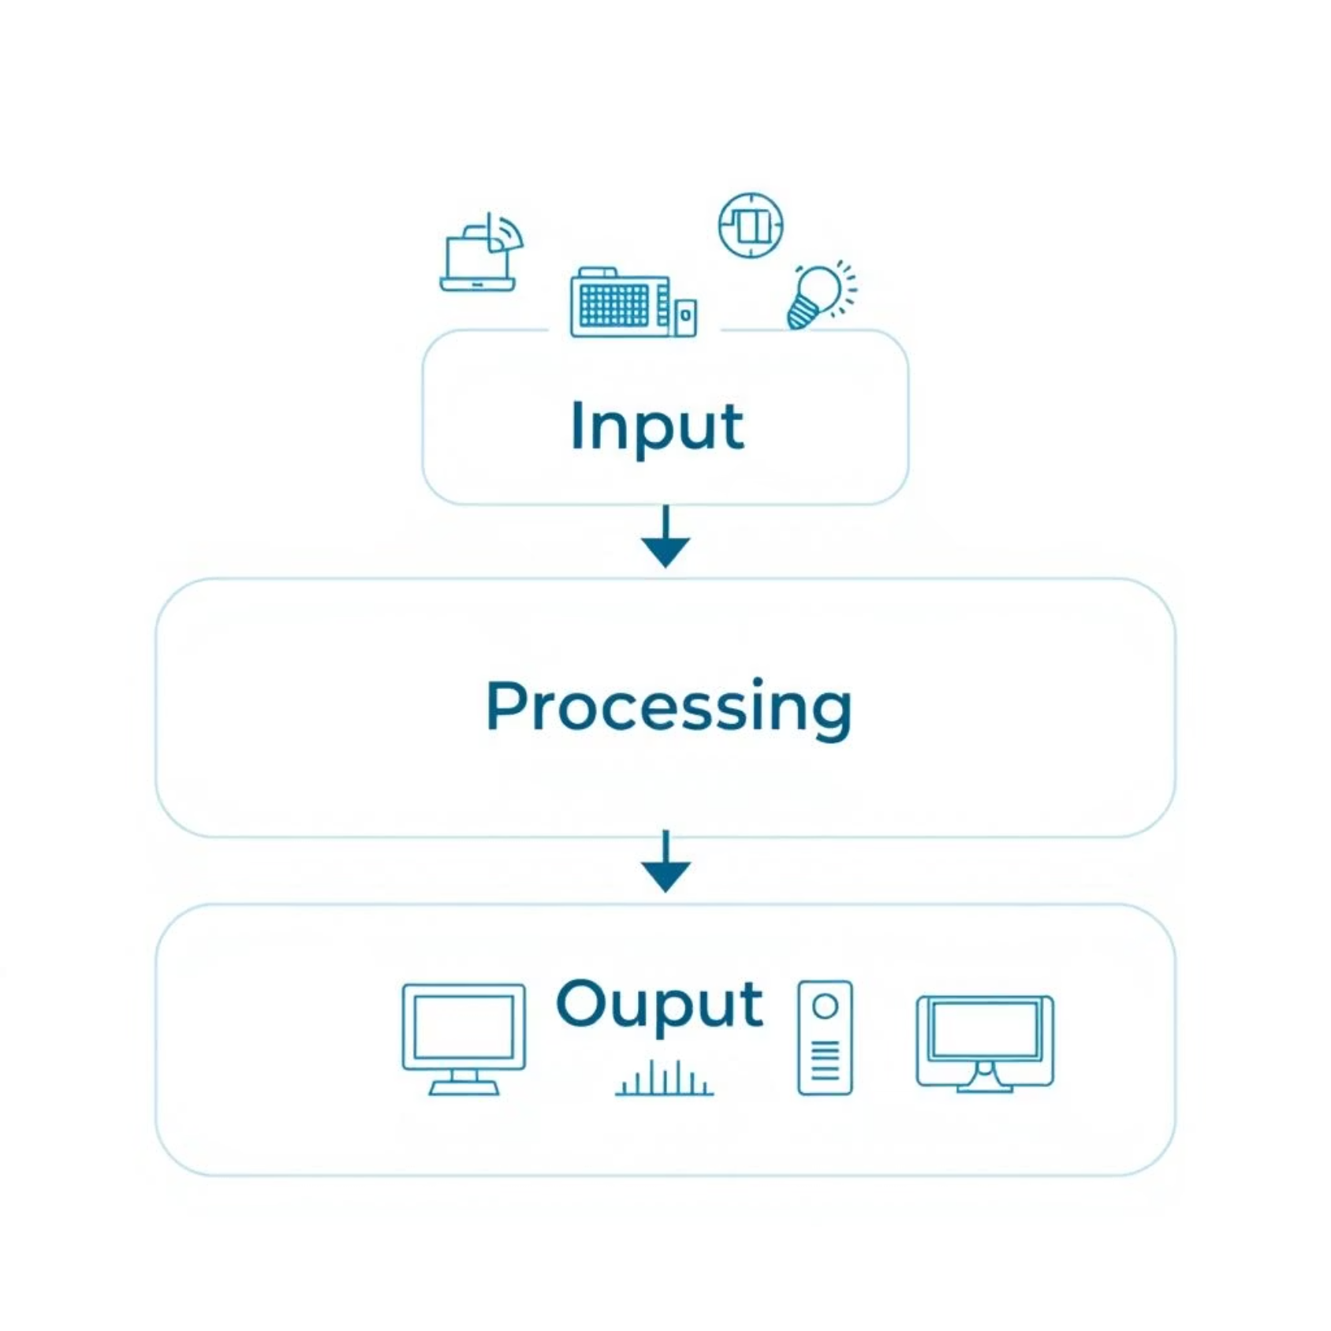
System Design Overview
Modular Architecture:
The system architecture includes the following layers:
1
Input Layer
Accepts text input via keyboard, speech input through microphone (processed by speech-to-text engine), and image input analyzed using OpenCV.
2
Processing Layer
NLP models like Flan-Alpaca interpret the question and generate an appropriate response. If webcam access is enabled, facial analysis determines student engagement levels.
3
Output Layer
Textual answers, generated visual aids (charts, diagrams), and engagement warnings are presented in a user-friendly interface developed using Gradio.

Slide 5
Key Features
Functional Highlights:
Multimodal Input Support
Emotion-Aware AI
Students can interact through voice, text, or by uploading an image.
Analyzes facial expressions in real-time to detect confusion, boredom, or engagement.
Visual Explanation Generator
Fallback Capability
Provides dynamic visual content such as charts, especially for science or programming queries.
If a direct answer is not possible, the assistant suggests alternatives, related concepts, or prompts students to rephrase the query.

Slide 6
Technologies & Tools Used
Development Stack and Datasets:
Development Stack:
Datasets:
Programming & Interface: Python, Gradio
LibriSpeech for training the STT system
Natural Language Understanding: Hugging Face Transformers (Flan-Alpaca base model)
AVA-Kinetics for behavior analysis and emotion classification
Speech Recognition: Whisper or Wav2Vec2.0 models
Custom Q&A dataset built for Physics, English, and Computer Science topics
Computer Vision: OpenCV for detecting facial expressions and image inputs
Acceleration & Optimization: OpenVINO for model execution on Intel hardware

Slide 7





Workflow Summary
Step-by-Step Interaction Process:
Submit Question
A student submits a question using voice, text, or image.
Process Input
Voice input is transcribed to text, and image input is scanned for relevant content.
AI Processing
The AI model processes the query and evaluates student engagement in parallel.
Generate Response
A response is generated based on context, emotion, and fallback conditions.
Deliver Response
The system delivers the response visually and textually through the interface.

Slide 8
Challenges Faced
Technical and Functional Hurdles:
Multimodal Syncing
Noisy Environments
Facial Expression Limitations
Combining audio, text, and image inputs into one pipeline posed complexity in synchronization and sequencing.
Voice recognition was affected by ambient noise and variations in pronunciation or accent.
Standard webcams provided inconsistent quality for accurate facial emotion analysis.
Real-Time Speed
Ensuring that the entire input-process-output cycle happened in under a few seconds was a major optimization challenge.

Slide 9

Results & Outcomes
Performance Achievements:
The assistant handled diverse input types effectively and returned relevant answers most of the time.
Speech and text input integration allowed more inclusive interaction for different students.
Facial expression analysis worked well under good lighting, successfully identifying disengaged users in test cases.
The fallback system played a vital role in keeping conversations going even when the model lacked an answer.

Slide 10








Conclusion & Future Scope
Impact & Expansion Plan:
The AI-Powered Interactive Learning Assistant is a step toward intelligent, inclusive classrooms. It responds not just to questions but also to student emotions. The system adapts and personalizes the teaching process, increasing both attention and comprehension.
Offline Operation
Multilingual Capability
For rural or limited-connectivity environments
Expanding reach to regional language classrooms
Deeper Personalization
Subject Expansion
Track individual performance and tailor responses over time
Include Chemistry, Biology, and Social Studies

